Slide 1
Mobile Proximity Services
Investment Opportunity
Proprietary and Confidential
Enpresence, Inc. 2006

Slide 2
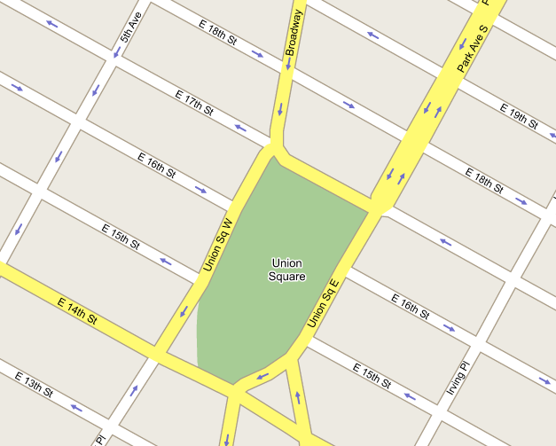
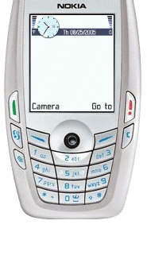
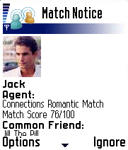

Mobile Proximity
Enpresence, a service company in the proximity detection market, alerts mobile users with offers that match their pre-set preferences when someone or something of interest is nearby.

Slide 3
The Company
Founded in May 2004 by Ben Taylor and Dave Cowing Headquarters in NYU Stern Incubator Patent Pending Proprietary technology for mobile devices Product in Beta test Executive Leadership
 | Ben Taylor - President 12 years experience Expertise: Technology visioning and business development Co-Founded Cambridge Technology Partners Internet division, grew to $120 million in 18 months Founded NerveWire, secured $60 million capital, sold to Wipro Founded E5 Systems, opened China market for outsourcing of IT services | Dave Cowing – COO/CTO 15 years experience Graduate: Stern Executive MBA Program Expertise: Technology leadership and management Co-Founded AdValue Network, sold to Reuters Co-Founded Cambridge Technology Partners Internet division, grew to $120 million in 18 months At ZEFER, grew NY technology team to 45 people in 1 year

Slide 4
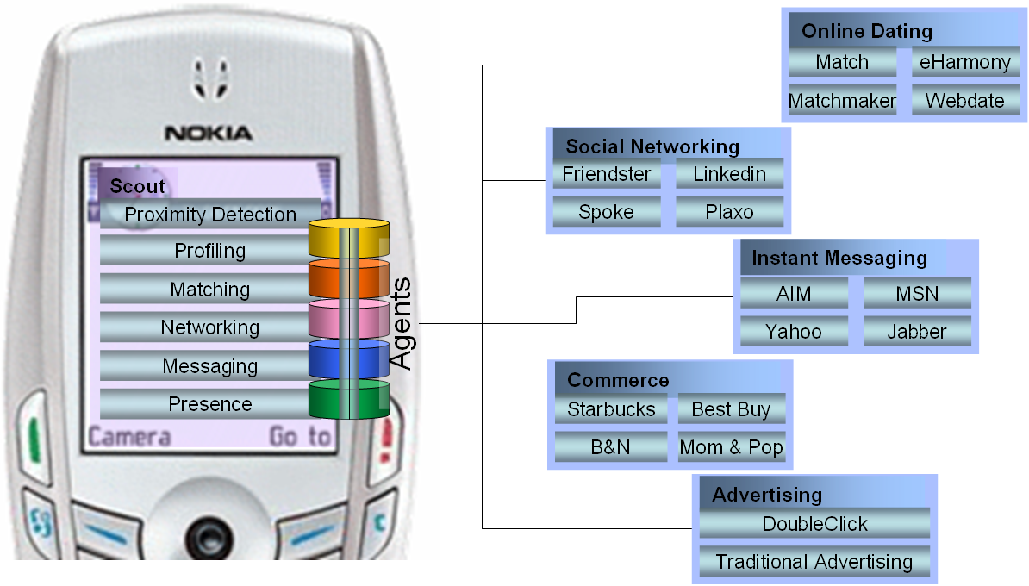
The Platform
Enpresence provides a platform through which a mobile user can access a variety of services and content that leverage proximity services and mobile agent technology.
Note: all names are illustrative.
Notes:
Enpresence is a platform through which a mobile user can access a variety of services that leverage proximity and active agent matching technology.
For example, a user can take their dating, social networking and retail loyalty programs with them.
Enpresence is intended to enhance the offerings of online networks, such as Match.com and Friendster. For example, a dating service might offer a premium service based on Enpresence to it’s users for $5/m/u.
Our approach to enhancing networks is different than other providers of proximity enabled software who compete directly against online dating service and social networks.

Slide 5
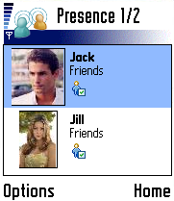
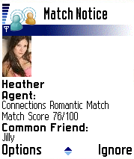




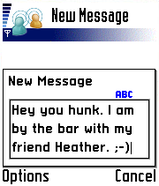


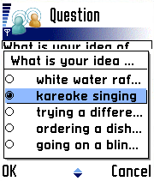
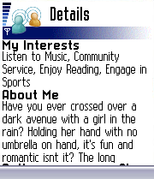
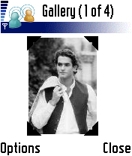

Scout Overview
Proximity Agents
Buddy List
Messaging
Quick Questions
Profiles
Image Gallery

Slide 6
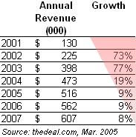
Market Opportunity
Online Dating
  Industry size: $516 million worldwide
  Consumer base: Over 30 million users
  Growth rate: 9% annually (revenue)
  Revenue sources: Subscriptions, advertising
  Pain points
    Reduced revenue growth, Increasing competition, High customer churn
Online Dating Services
Social Networking Sites
  Industry size: $N/A
  Consumer base: Over 70 million users
  Growth rate: Exponential user growth
  Revenue sources: Advertising, subscriptions, transactions
  Pain points
    Proliferation of sites, poor loyalty, poorly differentiated offerings
Value Proposition
Enpresence Service
Value
Members are notified when they have a match with a member who is nearby, based on pre-set preferences
Users can find friends who are in the area
Premium add-on service
Differentiator
Enhanced stickiness
Sources: thedeal.com, Information Today
Notes:
Our target markets are companies offering online dating and social networking services. The users of these services are early adopters of technology and have integrated it into their social life.
-Online Dating
-$516m global/245 US -> 9% growth
-30m global/14m users in us
-Social Networking
MySpace reports over 50 million users. When acquired had 37M users and sold for $580
While profits have been elusive, it’s only a matter of time until the site figure out how to monetize the large user bases.
Recent deals: MySpace, purchased by News Corp (through Intermix Media), Yahoo purchased Flickr and launched yahoo 360, Amazon invested in 43 Things, Monster bought Tickle
As mentioned earlier, Enpresence is intended to enhance the offerings of these services and provides value that specifically addresses the pain points in these industries
Enpresence can be offered as a premium service to customers to augment existing revenue. It will differentiate an online service from others and will enhance customer stickiness, by further integrating the service into their lives.

Slide 7
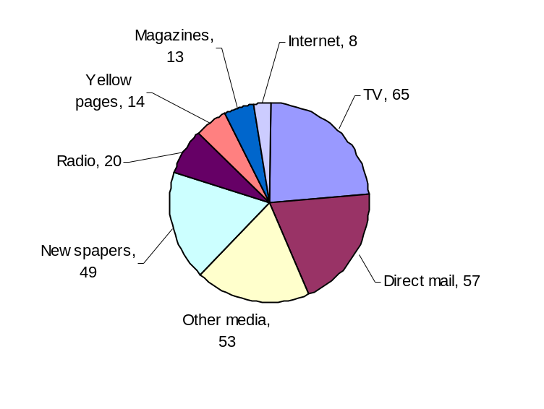
Future Opportunity
Advertising
  Industry size: $570b worldwide
  $278b US
  Pain points
    Media fragmentation, changes in media consumption
Retailing
  Industry size: Over $2.8 trillion US
  Pain points
    Customer loyalty, competition, online options
Hospitality and Entertainment
  Industry size: Over $1 trillion worldwide
  Pain points
    Customer loyalty, competition, price transparency
2005 US advertising spending ($US b)
Value Proposition
Enpresence Service
Value
User specifies products/services of interest, notified of those in area
Establishments may make customized time/location specific offers
Unique ability to target customers
Increase customer loyalty
Differentiation
Sources: WPP, Universal McCann, eMarketer
Notes:
While our focus and business model are based on the online dating and social networking industries, we see significant opportunity beyond them. Once we have the install base, we can offer huge value to users and to the advertising, retail, and hospitality industries.
Specifically, our platform will provide companies with a unique ability to target customers. By providing a proximity-based enhancement to interact with customers, companies will increase customer loyalty and add a point of differentiation from the competition.
Advertising:
-US about half of global spend
-Advertising is about 570b billion globally (Universal McCann – 2005 numbers)
-TV: ~$50b
-Newspaper: ~$50b
-online: $12 b (expected to grow to $26b by ’10 – forrester)
Total growth 5% y/y – WPP annual report 2004
Retail: size is ’03 number

Slide 8
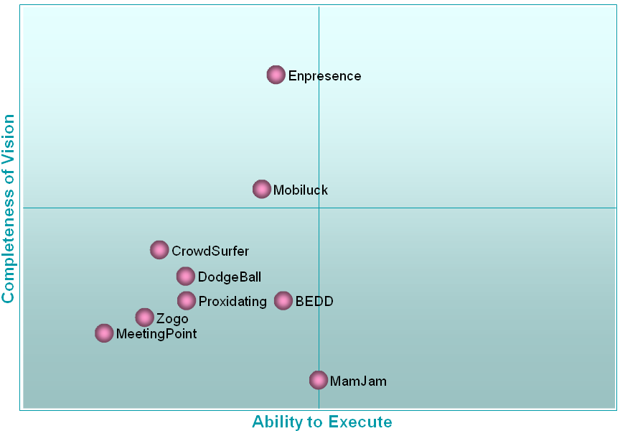
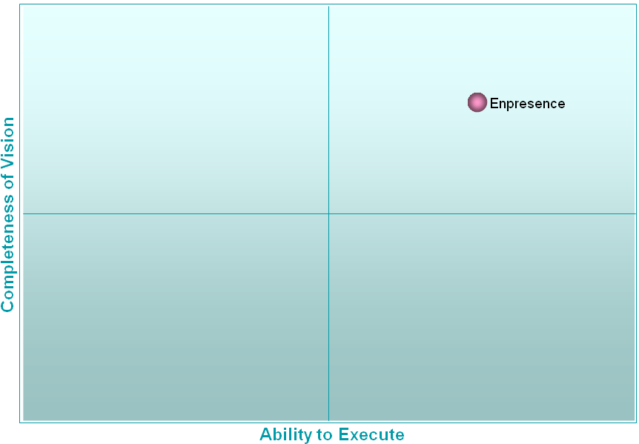
Competitive Landscape
Mobile Services
Mobile Enhancement to Online
Key Points
Most companies are trying to build their own network using application specific technology
Immature competitors (2 years old)
Highly fragmented with no clear winner
Our patented technology differentiates us by supporting multiple applications on the platform, based on each user’s preference
Key Points
Sell to existing network services as service enhancement
No competition
Existing networks don’t have the expertise to do mobile

Slide 9
Milestones
Milestones
May 2004 | 2 guys and a garage (well, Starbucks)
December 2004 | Completed proximity prototype
September 2005 | Entered the Stern Incubator
October 2005 | Filed patent application for mobile software
November 2005 | Began developing partnerships
December 2005 | Launched beta program at NYU
Q1 | Expand device support and user base
Q2 | Sign first dating service
Q2 | Market launch
Next Steps

Slide 10
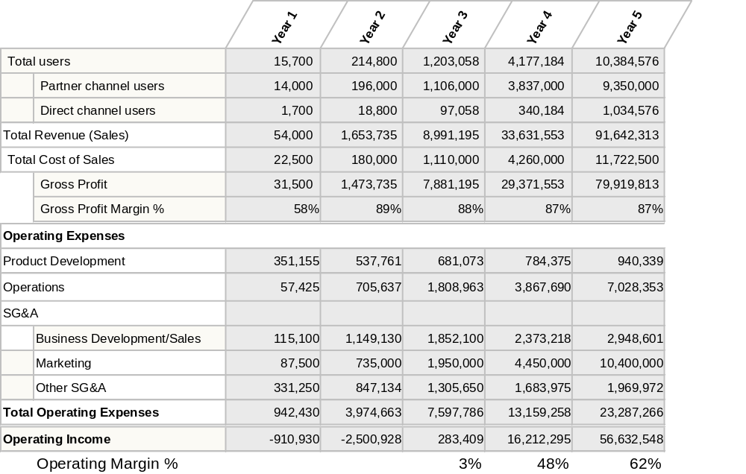
Pro Forma Financials
Notes:
I’d like to give you a glimpse at our business model. This is our pro-forma income statement. As you can see, we have two channels for selling to users, partners and direct.
In the partner model, we believe we can charge over $2/u/m, but have modeled it at $1. The growth is a combination of acquiring new partners (2,4,6,8,8) and growing penetration into each partners customer-base. Our focus in year one is launching the service and proving the offering with core customers. In year two, we’ll be focused on building a scalable business, with an eye toward growth in years 3-5.
In addition to partners, we’ll offer a service directly to consumers. We believe this is critical to have a direct connection to a base of mobile users, in order to better understand their needs and to continue to improve the offering, as well as to add additional offerings. In our model, we assume a price of $7.50/u/m for the service.
The cost of sales line includes only our hosting costs, which scale with the number of users on the service.
Dropping to the bottom line, we expect to achieve profitability in the 3rd year, Q3 and health margins after that.

Slide 11
Capitalization Objectives
Funding to date
  In kind capital: 3 man years
Current funding requirement
  Funding: $2 million
  Use of Funds
    Pilot service
    Expand device support
    Sign up customers
    Sign up partners
Total projected funding requirement
  Funding: $10 million
  Time to profitability: 2 ½ years

Slide 12
Q&A
What do you think?
Join our beta program:
http://www.enpresence.com/beta.html
Free promotional code: NYU2

Slide 13
Appendix

Slide 14
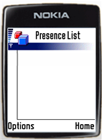






Agent Overview
Match Alert
Romance Match
Confidence: 83%
Alias: Dreamy
1. Detect Presence
2. Existing Relationship?
3. Send Match Criteria
4. Confirm Match
Match Alert
5. Add to Relationship Network
Romance Match
Confidence: 60%
Alias: Mr. Right

Slide 15



Scenario - Proximity Presence
6
t
h
A
v
e
5
t
h
A
v
e
57th St
Romantic
Party Animal
Disco Dancer
Cat Lover
Disco Dancer2
Local Presence
Expanded Presence - Internet

Slide 16
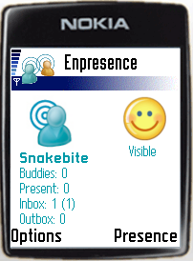


Scenario – Commercial Presence
Internet
Computer
Romance
P
a
r
k
A
v
e
6
t
h
A
v
e
Presence Detected
17th St

Slide 17
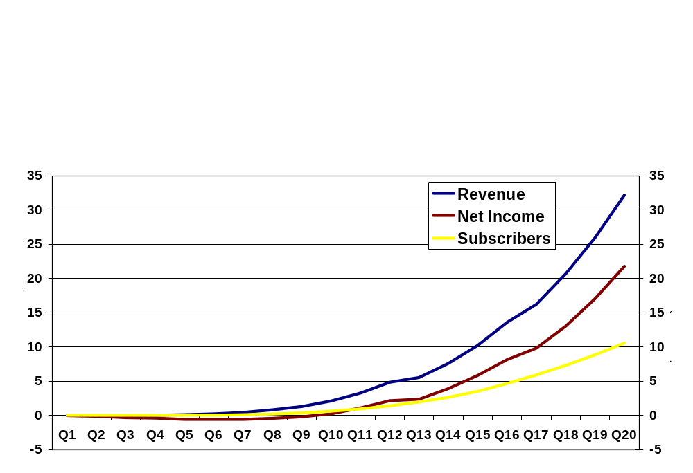
Summary Projections
Launch
Build
Grow
Pilot service
Acquire partners/ subscribers
Tune concept
Product development
Business development
Operations
Subscriber-base
Carrier/partner-base
Product offerings
Target international markets

Slide 18
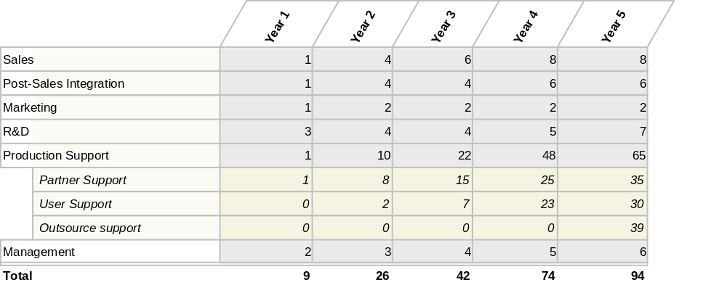
Staffing Summary

Slide 19
Model - Strategy
Goal: Build proprietary network of customers
  Develop subscriber-base of 4-5 million in 3 years
  Provide a range of consumer-oriented partner services utilizing proximity detection and active matching
Channel Strategy
Near-term
  Primary: Service Partners
    Online dating services
    Social/business networking services
  Secondary: Direct sales
    Web
    Relationship marketing
Long-term
  Carriers
  Handset manufacturers
Service Partner Strategy
Near-term
  Focus on social networking services
    Online dating services
    Social/business networking services
Long-term
  Expand range of service partners

Slide 20
Model – Pricing
Service | Revenue Model | Price | Revenue | Channel
Messenger | Transactional | $0.10 | 50% | TBD
Scout | Subscription Transactional | $5 to 7.5 $0.10 | 30 to 50% 50% | Co-branded with Partner Transition to branded client
Networker | Premium Subscription | $10 to 15 | TBD | Branded direct through carrier
Alternative models to be explored
  Prepaid transactional pricing model for Scout and Networker
  Sponsorship/CPM model for offers
  Alternative plans for retail loyalty programs

Slide 21

Offering – Service Levels
 | Messenger | Scout | Networker
Manual Location Sharing
SMS Messaging
Presence Detection and Sharing
Mobile Agent Technology
Instant Messaging
Mobile Dating Channel
Intelligent Location Sharing
Enpresence Relationship Network

Slide 22
Offering - Scout Overview
Channels
Mobile/Online Dating
Features
Mobile Connected Presence
Buddy List
Moods
Proximity Detection
User Configurable Agents
Messaging (with anonymity)
Image Sharing
Profile Sharing
Privacy Features
Rich Easy to Use Interface
Technology
Secure Transfer & Storage
Server Synchronization
Bluetooth and TCP/IP Middleware
Built on Open Standards & Technology

Slide 23
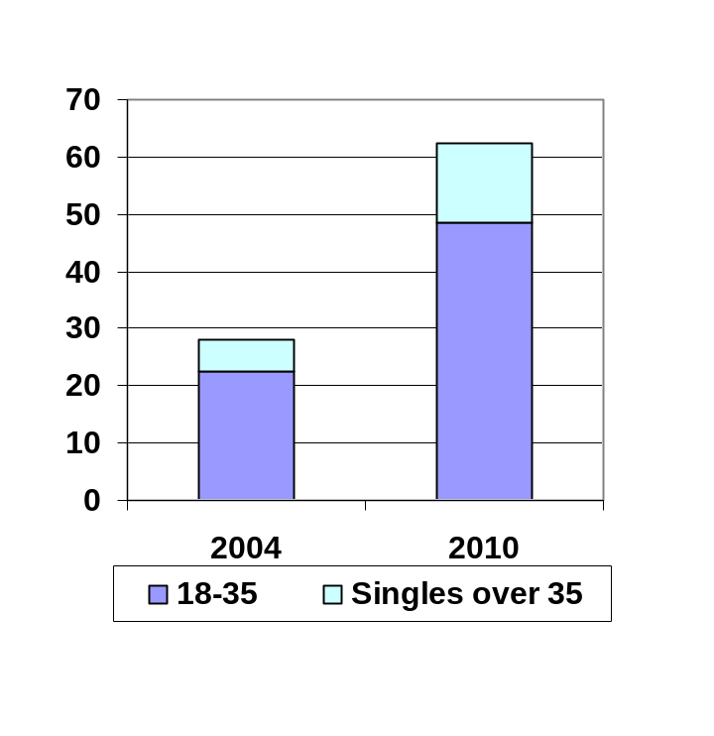
Opportunity – US Market
Mobile Relationship Networking is a portion of a large and rapidly growing data services market …
… and the total number of prospective consumers is expanding as a result
Internet Dating
Size: $516mm
CAGR: 9%
Mobile Data Services
Size: $5.2b
CAGR: 64%
SMS
Size: $4.4b
CAGR: 64%
Mobile Relationship
Networking
Social
&
Professional
Networking
* 2005 estimates, with projected 4 year CAGR
NOTE: Global market for Mobile Data Services was $16.7B in 2003 and is expected to grow to $77B in 2007.
NOTE: Of Cingular’s 46mm customers, 80% were data enabled and 18mm were active data users as of Q1 2005**
Notes:
*Sources: Cheryl Meyer, "The match game," TheDeal.com, Mar 21, 2005, Jupiter Research; Catherine Taylor, "MMA In The News : The text files: is it time for advertisers to jump into cell-phone messaging?," Mobile Marketing Association, July 12, 2004. [In-Stat/MDR]; US Census 2000; eMarketer, July 2004, “Wireless Content,” Noah Elkin; eMarketer, 2005, "US Wireless subscribers, by Age, US Wireless Subscribers, by Age, 2004 & 2010“; “US Wireless Voice and Data Market, 2000-2007,” eMarketer, 2004
** Ralph de la Vega, COO Cingular, Lehman Brothers Worldwide Wireless and Wireline Conference, June 2005

Slide 24
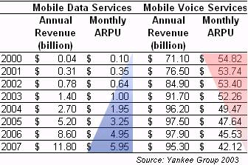
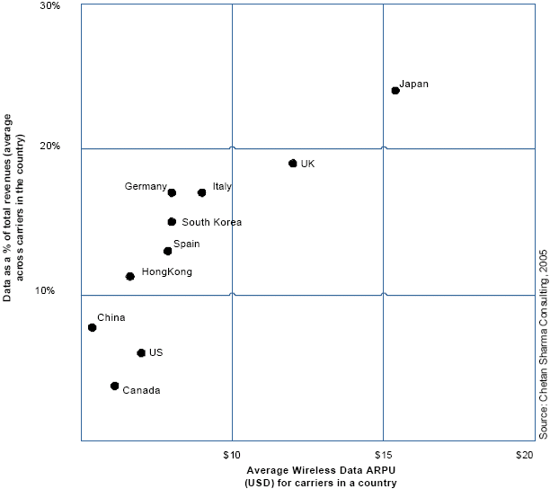
Opportunity – Mobile Telecom
Voice ARPU dropping
  Industry voice ARPU expected to drop to $42.12 by ‘07 (from $54.82 in ’00)
  Cingular voice ARPU for the last 4 quarters has dropped 3-6% YoY
Data ARPU growing
  Industry data ARPU expected to grow to $5.95 by ’07 (from $0.10 in ‘00)
  Cingular data ARPU has grown from $1.10 in Q404 to 3.70 in Q105
  Carriers seeking products and services to drive data revenue
Countries with more mature wireless industries have significantly higher proportions of data revenue
Introduction of 3G technologies help carriers boost data ARPU
  Cingular deployed 3G network to 20 cities in 2005
Carriers seeking differentiation to reduce churn
Mobile Telecom Services
Notes:
Sources: Cingular, Lehman Brothers Worldwide Wireless and Wireline conference, 2005
Yankee Group, 2003
Chetan Sharma Consulting, 2005

Slide 25
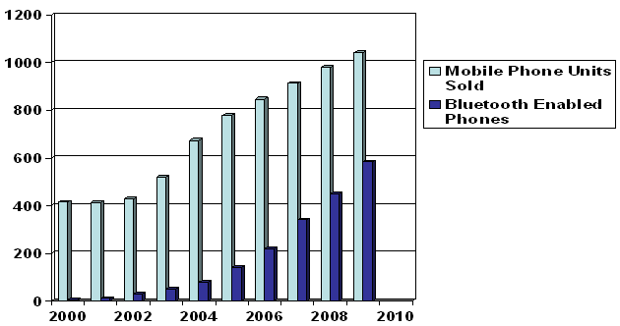
Mobile Phone Growth
In 2009 over 1 billion mobile phones will be sold annually
There will be 2.6 billion mobile phones in use by 2009
133 million Bluetooth enabled phones sold in 2005
Global Bluetooth mobile phone sales expected to rise 65 percent year-on-year in 2006
Projected 220 million Bluetooth enabled phones to be sold in 2006
Bluetooth Penetration
Bluetooth is a technology used to transmit information wirelessly between devices such as mobile phones, computers, and accessories like headsets.
Notes:
Reuters 1/4/2006

Slide 26
Strategy
 | Product Development | Sales & Marketing | Operations
Goals | Expand application features Grow mobile devices supported | Acquire customers Tune service feature set | Build effective customer care (quality/cost)
Strategy | Utilize standards (e.g. Java) to facilitate portability Target most popular mobile OS’s (e.g. Symbian/Series 60) to optimize phone coverage Utilize offshore resources for non-value add activities (e.g. product testing & porting) | Target dating partners initially to rapidly develop network Do some selling direct to consumers to develop a relationship for use in feature analysis and feedback Once concept proven, partner with carriers to expand service reach | Partner/carrier support to remain in house to ensure high-quality relationships Handle core consumer support in house to develop expertise Additional production support requirements will be outsourced

Slide 27
Risks
Risk Area
Mitigation Strategy
Competition | Develop subscriber network rapidly Monitor competitors & substitutes
Power of Carriers | Prove viability of model Demonstrate value to carrier, specifically data usage
Security | User & app to app authentication No exchange of core user data between devices Encryption & authentication to central servers
User Privacy | Specific consumer data not shared with 3rd parties User has complete control over own information (privacy mode, blocking, post-match interaction)
Technology Innovation | Platform architected to include relevant new technologies Watch for opportunities with emerging technologies

Slide 28


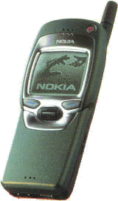
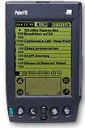








US Mobile Value Chain
Network & Equipment
Software
Services
Distribution
Infrastructure
Infrastructure
Software
Portal
Mobile
Network
Operators
Mobile
Service
Providers
Consumer
Components
Content
Distribution
Channels
Handsets/
Devices
OS/API/GUI
Apps
Other than MNOs
Bank
IM
Shop
News
Game
Chipsets
  Qualcomm
  Motorola
  Lucent
  Intel
  Samsung
  Nokia
  TI
Infrastructure
  Ericsson
  Nokia
  Motorola
  Nortel
  Lucent
  Cisco
  Samsung
Handsets/ Devices
  Nokia
  Motorola
  Sony-Ericsson
  LG
  Samsung
  BenQ/Siemens
  Palm
  RIM
Enabling software & solutions
  Infrastructure/ handset makers
  Openwave
  IBM
OS/API/GUI
  Symbian
  Microsoft
  Sun
  Palm
  Openwave
  RIM
ISPs/Portal
  AOL
  Yahoo
  MSN
  Club Nokia
Destination
  Amazon
  eBay
  Citibank
  Fidelity
  Sony
Games
  JamDat
  Digital Chocolate
Content
  Ringtones
  Wallpaper/Logos
  Music
Carriers
  Cingular
  Verizon
  Nextel/Sprint PCS
  T-Mobile
Resellers/MVNOs
  Virgin Mobile
  Boost Mobile
  Liberty Wireless
  Omni Prepaid Cellular
Retail chains
  Radio-Shack
  BestBuy
  Staples
  CircuitCity
  WalMart
  Office Depot
Dealer /Agent network
Operator direct
  Operator owned stores
  Sales force

Slide 29
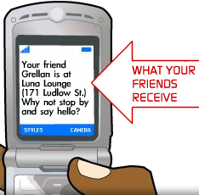
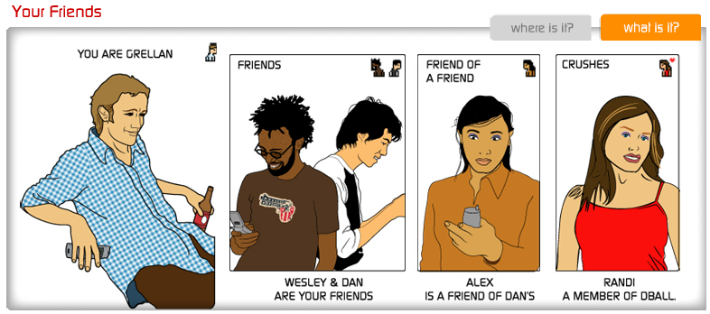
Competitive Landscape – Dodgeball
Dodgeball.com (google)
Dodgeball is a New York based SMS Relay business that enables subscribers to broadcast their location to other members within a ten block radius. Subscribers send SMS text messages to a central service with their location which is then relayed to other members in the surrounding area
Estimated to have over 10K registered uses
Key Features
Web community for buddy searching
Broadcast location of friends and people subscribers have identified to be notified of (crushes)
Requires manual transmission of subscriber location/presence
Business Model
SMS advertising to subscribers
Currently no fee of any kind to subscribers
Technology Platform
The Dodgeball solution does not require a client installation and relies entirely on the SMS/MMS transport protocols
The server component hosts a website built in PHP and some backend technology for relaying SMS messages to other subscribers in the same general vicinity
Device Support
Dodgeball will work with any device that supports SMS messaging

Slide 30

Competitive Landscape – BEDD
BEDD
BEDD is a Singapore based provider of community oriented mobile software.
BEDD allows users to meet, chat and interact with each other by using mobile phones for friendship and dating, buying and selling, networking, alerting when friends and family are close by and free Bluetooth chat and instant messaging.
Key Features
Automated Bluetooth enabled proximity detection and notification
Proximity profiling and criteria based buddy matching
Messaging, chat, mobile classifieds, games, and dating
Business Model
Periodic subscription fee
Revenue streams for operator, manufacturer and content providers
Technology Platform
C or C++ client software
Phone 2 phone- no server nor service to operate, no central database nor registration required. There is no web component to the service as it is entirely mobile device based
Device Support
OS that utilizes Bluetooth wireless technology
Most high-end Nokia Series 60 phones
Siemens SX-1
Sendo X

Slide 31
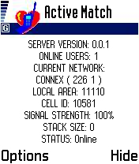
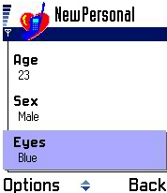
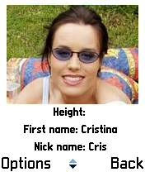
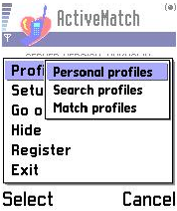
Competitive Landscape – ActiveMatch
ActiveMatch
ActiveMatch is the first application of its kind to combine location information with a matchmaking database to create a new kind of service for mobile phone users
ActiveMatch blends the convenience of a location-based service with the entertainment of a game-like utility and the excitement of instant gratification and defeating loneliness
Key Features
Automatic location detection using cell triangulation (needs to be confirmed)
Proximity profiling and criteria based buddy matching
Business Model
Advertising
Licensing (subscription and flat fee)
Technology Platform
ActiveMatch works in any GPRS network and on all mobile phones with Symbian OS and Nokia’s Series 60 platform. The system consists of a client running on the mobile phone and a server application managing the database of user settings and profiles, as well as their location information
Device Support
Devices running the Symbian OS and Nokia’s Series 60 platform.
ActiveMatch functions without the support of a network operator

Slide 32



Competitive Landscape – WhoAt
WhoAt
WhoAt lets you find dates and friends anywhere, anytime. Tell WhoAt where you are and we tell you who's nearby - all from your mobile phone, PDA, or PC.
Key Features
WAP Interface combined with SMS messaging
Profiling, matching, messaging
Manual location broadcasting
Business Model
Unknown
Technology Platform
Built on an SMS and WAP platform
Matching occurs on a server based on known geographical locations and proximity to them
Supports web, PDA, and mobile phone clients with web access
Device Support
Any device supporting SMS and WAP

Slide 33







Enpresence Server Overview
User Services
Member’s Web Site
Member’s WAP Site
Integration Services
PoP Server
Remote Service Manager
Web Services
Presence Server
Platform
Core Services
Data Management
PoP
Server
WAP
Application
Web
Application
Remote Svc
Manager
Core Application Services
Web
Services
Presence
Server
DAO
Enpresence
Database

Slide 34
Architecture Overview
Distributed
Mobile Device
PoP
Server
Mobile App
Central
Remote
Service
Manager
Member’s
Web Site
WAP
Site
Enpresence DB
Presence
Server
Web
Services
IM Clients
Content/Service Partners
Yahoo IM
AOL IM
Dating
Retail
MSN IM
Jabber IM
Note: all names are illustrative.
Notes:
Needs visual work. Add a legend

Slide 35
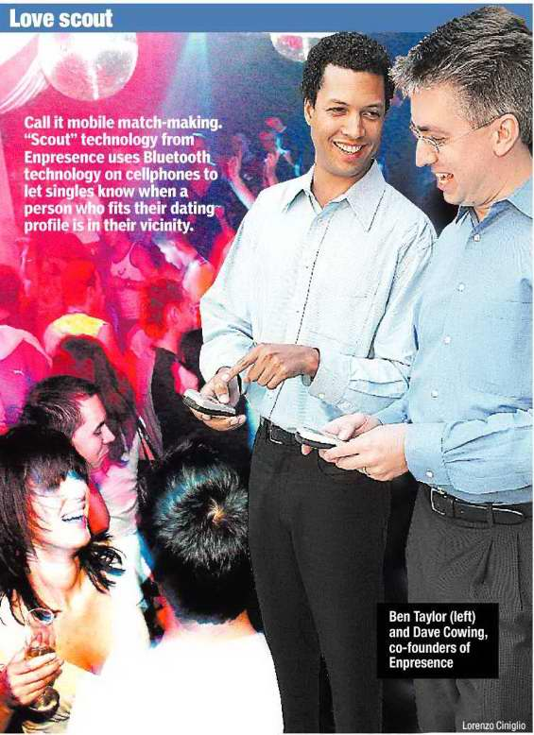
Accolades
“A sure-fire consumer hit, if Ben Taylor and Dave Cowing have any say in the matter. “
Notes:
Tech firm’s love search
Duo goes for mobile mating
By COELI CARR
What do you get when you cross a cellphone with a match-making service and a bit of Bluetooth technology and some high-brow proximity theory thrown in?
A sure-fire consumer hit, if Ben Taylor and Dave Cowing have any say in the matter.
“Once you have an idea that’s caught on, especially with consumer tech, the ratio of what you put in and what you can gain in revenue can be very large,” says Cowing, who, with Taylor, co-founded and own Enpresence (www.enpresence.com).
“That’s the Microsoft story 20 years ago and the iPod story today. Consumer tech that catches on can be huge.”
Taylor and Cowing, both in their 30s, are the guiding force behind Enpresence’s new product, “Scout.”
“Scout” lets a cellphone carrier, in tandem with a match-making service, help find romance for its subscribers.
The product lets the mobile-phone subscriber know that a person who fits their dating profile is in the vicinity.
Confused?
Think back to the scene in the movie “Minority Report,” where Tom Cruise’s Jon Anderton enters a clothing store.
A disembodied voice —the computer system has read Anderton’s newly installed eyeballs — greets him as Mr. Yakamoto.
“It knew he had come into the store; that’s a core concept of proximity,” said Cowing, Enpresence’s executive vice-president, who describes himself as a “gadget head.”
Taylor, the company’s president, and Cowing met about 10 years ago when they both worked at Cam-bridge Technology Partners and decided to push proximity theory even further.
“Our thought was, wouldn’t it be nice if we could take advantage of these serendipitous passings among people, like ships in the night, and provide a little more information, such as letting them know that someone they might like to meet was in the vicinity,” said Cowing.
The duo then looked around for a technology that could communicate when two phone devices were within some distance of each other.
“We looked at other technologies, but Bluetooth is gaining significant adoption, so it’s out there on a large and growing number of phones, which is key,” said Cowing.
“Most people have been using Bluetooth as a wire replacement technology so that you can, say, install a videogame on your phone from your computer.”
He and Taylor, with what they call a fairly complete first version of “Scout,” have had conversations with a number of dating services and mobile-phone carriers.
“The carriers, like Cingular and Verizon, control the mobile-phone space,” Cowing said.
With an eye toward partnering with a dating company, where “Scout” would be an extension of a matchmaking company’s objectives, Taylor says he and Cowing are talking with interested parties, looking for seed money, and setting up demonstrations.
The creators believe dense urban areas and college campuses are ideal targets for “Scout.”
With new, smaller matchmaking services entering the fray to compete with the bigger entities like eHarmony or match.com, Cowing believes “Scout” can become a unique calling card for the right company.
The pair hope to have some sort of agreement in place by year end. But industry observers say competition is fierce.
“A lot of people are trying to build applications for mobile technology,” said Paul Sagawa, a technology analyst with Sanford C. Bernstein, who added that companies like Verizon, Sprint and Cingular want to control these applications.
Unless Enpresence is “in presence” with these companies, and unless you can get “Scout” on your mobile phone, it doesn’t matter, Sagawa said.
Enpresence and “Scout,” however, have already gotten a strong endorsement.
Two months ago, the company beat out 22 other applicants and was invited into the Stern Incubator (www.sternincubator.com), an initiative that’s part of the Berkley Center for Entrepreneurial Studies, which is, in turn, a part of New York University’s Stern School of Business.
To apply for Incubator status, at least one company member must have Stern affiliation (Cowing received his M.B.A. from Stern early this year).
The honor comes with an assortment of benefits, such as free office space and access to legal and accounting firms. Even more valuable, said Cowing, is “access to advice from the Stern faculty and external advisors.”
“We think there’s a viable upside to the product and we believe in the team,” said Elizabeth Ingrassia, the creator and director of the Stern Incubator. “We’re looking for products with a large and growing market and where people are willing to spend a good amount of money for such a product.”
The guys from Enpresence know their time-frame of hitting it big is limited. “With tech, you have a much shorter product life cycle than you do in other industries,” said Cowing.
“In pharmaceuticals, you may have a 20-year life cycle for a drug. A tech product might have a one-year life cycle.”

Slide 36

Demonstration

Slide 37
Demonstration Overview
Scenarios
Mobile Social Networking
  Members enhance social interaction with proximity-based services
Mobile Dating
  Members extend online dating to the real-world through mobile –proximity-based services
  Serendipitous meetings enhance personal connections while matchmaking in the real-world

Slide 38
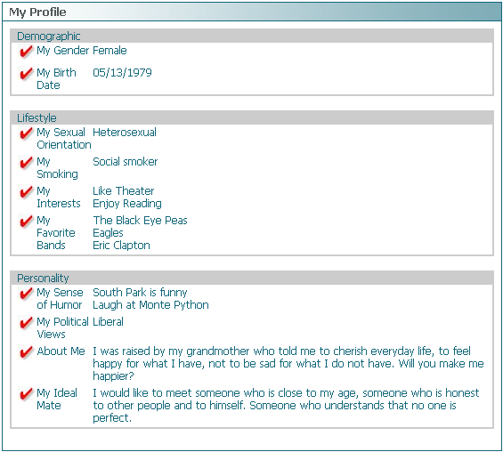
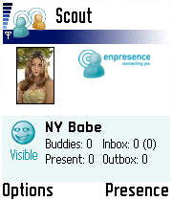
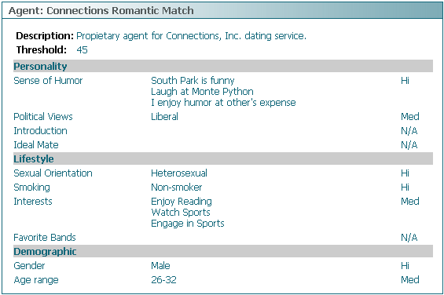
Scenario Member: Jill

Slide 39
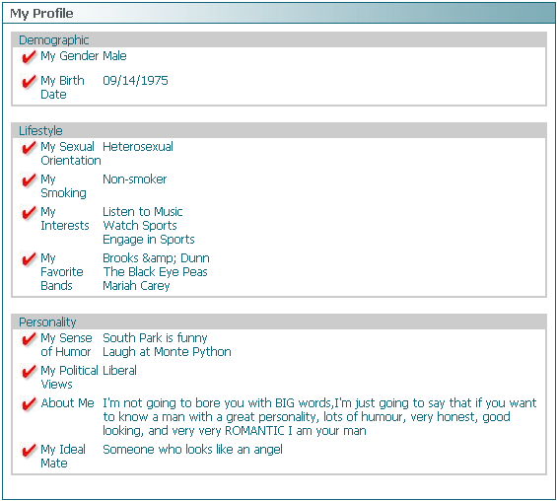
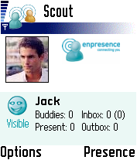
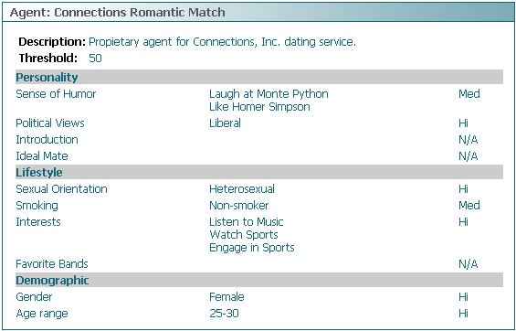
Scenario Member : Jack

Slide 40
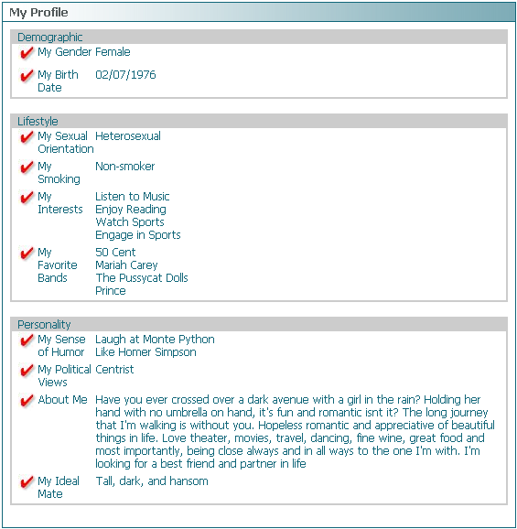
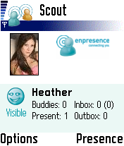
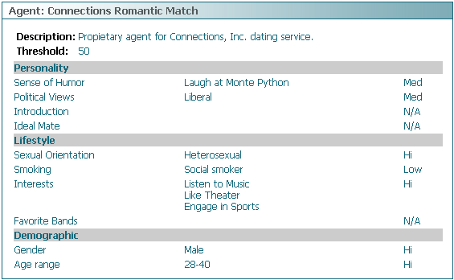
Scenario Member : Heather

Slide 41
Scenario: Mobile Social Networking

Slide 42
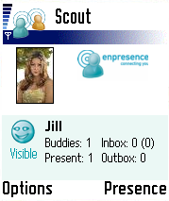
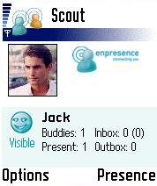
Scenario: Mobile Social Networking
Jack just entered a bar
Jack is friends with Jill
Automatic Presence Detection

Slide 43
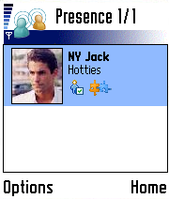
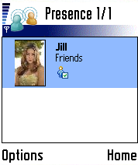


Scenario: Mobile Social Networking
Presence list shows Jack and Jill they are close by
Proximity-based presence sharing

Slide 44
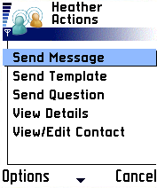
Scenario: Mobile Social Networking
Jill sends Jack a quick message
Freeform or templated messages and questions
Member profile details include profile and picture gallery
Full contact management

Slide 45
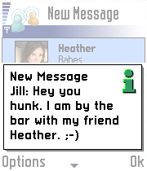
Scenario: Mobile Social Networking
Jack receives Jill’s message
Messages can be sent via Bluetooth with no data transmission charge
Alternately messages can be sent using SMS

Slide 46
Scenario: Mobile Dating

Slide 47
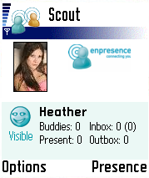
Scenario: Mobile Dating
Heather is friends with Jill
Jack has never met Heather
Heather and Jack are in the same bar
Automatic presence detection
Dating agent triggered by presence detection

Slide 48
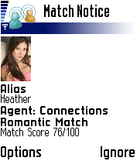
Scenario: Mobile Dating
Dating agent finds a match
Dating agent notifies users when a match occurs
No personal information is exchanged between devices

Slide 49
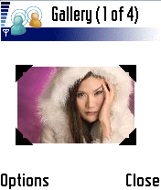
Scenario: Mobile Dating
Jack & Heather request image galleries and review them
Image galleries are downloaded from the web
Galleries are exchanged between users via Bluetooth upon request

Slide 50

Scenario: Mobile Dating
Heather accepts Jack into her network
Jack reviews Heathers bio
Members extend their network by adding to their ‘buddy list’
If a member is blocked they will never appear to be present to the blocked

Slide 51

Scenario: Mobile Dating
Jack, Jill, and Heather are all share personal networks
Presence list shows all members close by
Social networking advances

Slide 52

Scenario: Mobile Dating
Jack receives Jill’s message
Relationship building is accelerated with quick ‘get to know one and other’ questions

Slide 53

Scenario: Mobile Dating
Jill sends back her response
The potential is awesome

Slide 54

Ben Taylor
President and Co-Founder
Email: btaylor@enpresence.com
Phone: 917-208-6124
David Cowing
Executive Vice President and Co-Founder
Email: dcowing@enpresence.com
Phone: 917-716-8061

